Slide 1
Islamic Scripture Class Epping West Public School
Lesson 2: Prophet Nuh (AS)
July 25, 2023

Slide 2
Islamic Scripture Class Kindy

Slide 3
The Ark
Lived for 1100 Years
Taught people to do good things for 950 years
Once Upon a Time…
A wise man named Prophet Nu (AS) who lived for 1100 years

Slide 4
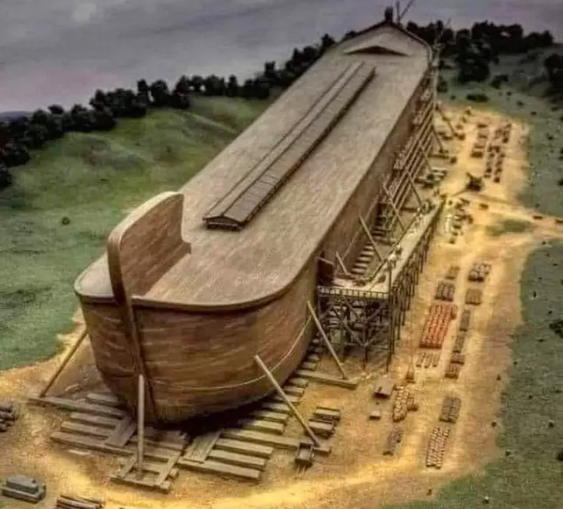
ALLAH (SWT) asked Prophet Nuh (AS) to build a GIGANTIC ship
Prophet Nuh (AS) worked hard by cutting the wood and building the Ark
All good People and pairs of Animals and Birds came on the big ship

Slide 5
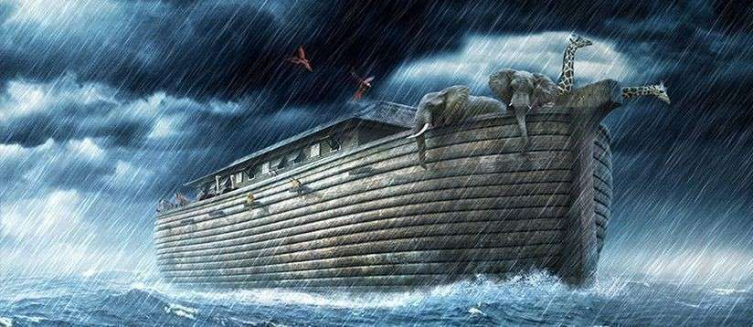
A Big Storm came and it rained for many days & nights
Water everywhere
After many days, the Ark rested on a Mountain and everyone get off
Always Listen to ALLAH SWT and Trust Him

Slide 6
Islamic Scripture Class Year 1-2

Slide 7
Who is a Prophet?
Nabi (Prophet): Who taught the Rules of the Prophets before them
Rasool (Messenger): Who was given a book or New rules from ALLAH (SWT)
What was Prophet Musa AS? What was Prophet Muhammad (S.A.W.W)

Slide 8
Guess the name of the Prophet
A Gigantic Ship
A Big Storm
1100 Years Old

Slide 9
The Ark
Lived for 1100 Years
Taught people to do good things for 950 years
Surah Nuh (71)
Once Upon a Time…
A wise man named Prophet Nu (AS) who lived for 1100 years

Slide 10
Prophet Nuh (AS) told people to pray to ONLY ALLAH (SWT) For 950 years He kept trying to guide people He was Gentle, Calm, Patient & Brave ALLAH instructed Prophet Nuh (AS) to build an Ark

Slide 11
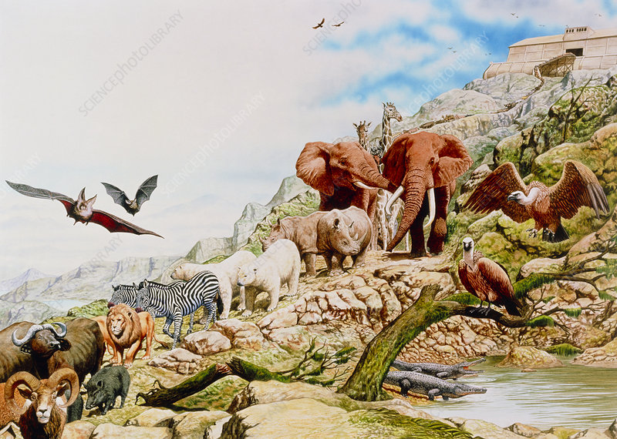
ALLAH (SWT) asked Prophet Nuh (AS) to build a GIGANTIC ship
Prophet Nuh (AS) worked hard by cutting the wood and building the Ark
People made fun of Prophet Nuh (AS)
All good People and pairs of Animals, Birds, Reptiles came on the big ship

Slide 12
A Big Storm came and it rained for many days & nights
Water EVERYWHERE
After many days, the Ark rested on a Mountain and everyone get off
They thanked ALLAH SWT for keeping them safe

Slide 13
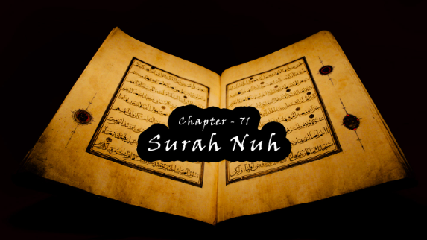
What did we learn?
Our Goal is to please ALLAH SWT
Have a Can-do attitude
Listen to & Obey ALLAH SWT

Slide 14
Islamic Scripture Class Year 3-6

Slide 15
Who is a Prophet?
Nabi (Prophet): Who taught the Rules of the Prophets before them
Rasool (Messenger): Who was given a book or New rules from ALLAH (SWT)
What was Prophet Musa AS? What was Prophet Muhammad (S.A.W.W)

Slide 17
Prophet Nuh (AS)
ALLAH SWT named 71st Surah after Prophet Nuh AS
He lived for 1100 years
People had forgotten about ALLAH SWT
For 950 years Prophet Nuh called people to believe in oneness of ALLAH SWT
He was strong, patient, calm and brave
People did not listen & ridiculed him so Prophet Nuh prayed to ALLAH SWT
ALLAH SWT told Prophet Nuh that a catastrophic storm is coming so build an Ark

Slide 18
Prophet Nuh (AS) worked hard to build the Ark over the years
Complete faith in ALLAH SWT
People mocked him & teased him
His own son Kanan was a disbeliever
One pair of Every known kind of Animal and bird was taken on-board along with all the believers

Slide 19
The terrible storm came and it filled the whole Earth with water
People ran towards the mountains to take refuge
After many days the rain stopped and the Ark rested on a Mount Judi in Turkiye
The survivors thanked ALLAH SWT for keeping them safe

Slide 20
What did we learn?
Patience: Prophet Nuh AS preached for 950 years
Persistence: He never gave up
Prayer: Asked ALLAH SWT for help and made Dua
Positivity: Success only comes from ALLAH SWT

Slide 21
Key Lessons to Remember!
Learn to be patient
Follow ALLAH SWT Always and have strong Faith in HIM
Dua is the Key
Have a Can-do Attitude
Take good advice of your parents

